Slide 1
Webinar 24
Supporting the wellbeing of infants and children through a trauma-informed lens
7:15 pm to 8:30 pm AEDT Wednesday, 2nd March 2022

Slide 2
Emerging Minds and MHPN wish to acknowledge the Traditional Custodians of the lands across Australia upon which our webinar presenters and participants are located.
We wish to pay respect to the Elders past, present and future for the memories, the traditions, the culture and hopes of Indigenous Australia.

Slide 3
Welcome to series four
This is the fourth webinar in the fourth series on infant and child mental health, presented by Emerging Minds and the Mental Health Professionals’ Network.
Series 4 webinars:
Assessment and engagement with infants and children (7 April 2022)
Building parents’ understanding of play to promote infant mental health (June 2022)
Subscribe to receive your invitation: www.emergingminds.com.au/Subscribe

Slide 4
How to use the platform
To interact with the webinar platform and to access resources, select the following options:
Information: To access presentation information, links for live chat, resources and webcast support, click on this icon located in the lower right corner of your screen.
Ask a question: To ask the speakers a question, click on the speech bubble icon in the lower right corner of your screen.
Chat: To open the audience chat box, click on this icon located in the top right hand corner of your screen.
Change slide and video layout: To change the layout, e.g. make the video larger and the slides smaller, click on this icon in the top right corner of the slide window.
View: To change your view to slide only or video only, click on this icon in the bottom right corner of the slide or video window.
Survey: To access the survey before the webinar ends, click on this icon in the lower right corner of your screen.

Slide 5
Learning outcomes
At the webinar’s completion, participants will be able to:
Discuss the evidence behind the prevalence and effects of complex trauma on early child development and wellbeing.
Discuss the approaches which support a trauma-informed approach, and how these can support children and their parents.
Outline the skills required to recognise and respond to the effects of complex trauma in practice with infants and children, and their parents and caregivers.
Outline the skills required to have preventative and early intervention conversations with parents and caregivers of infants and children who have experienced complex trauma.

Slide 6
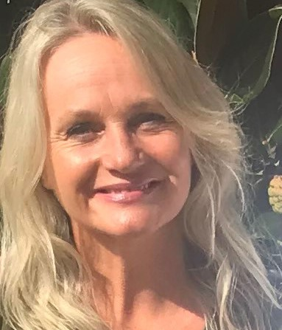
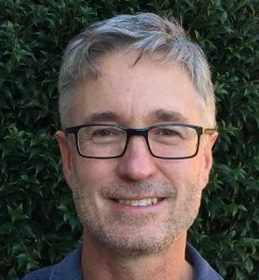
Tonight’s panel
Dr Jasmine MacDonald
Senior Research Officer
Australian Institute of Family Studies, VIC
Kathryn Lenton
Program Manager of
Therapeutic Services Australian Childhood Foundation, TAS
Alma-Jane O’Donnell
Perinatal and Infant Mental Health Specialist, SA
Facilitator:
Chris Dolman
Emerging Minds, SA

Slide 7
Senior Researcher’s perspective
Complex trauma
Jasmine
Definition: repeated exposure to severe stressors or potentially traumatic events over an extended period of time.
Common kinds of complex trauma experiences in infancy and early childhood in Australia:
physical, emotional or sexual abuse
neglect
family and domestic violence.

Slide 8
Senior Researcher’s perspective
Risks factors
Jasmine
Negative effects tend to be more long term and severe when trauma experiences:
occur earlier in a child’s life
have a longer duration
involve multiple forms of trauma experiences.

Slide 9
Senior Researcher’s perspective
Protective factors
Jasmine
Factors that can support positive outcomes and recovery include having a caregiver who:
is stable and responsive
applies positive parenting practices (e.g., engaged and warm)
believes and validates the child’s trauma experiences
can self-regulate their own emotions (their own = caregiver’s emotions).
Additionally, a positive emotional support network.

Slide 10
Senior Researcher’s perspective
Changes in stress responses
Jasmine
Perception of threat leads to stress response survival system activation:
fight (vigilance, agitation, anxiety or aggression)
flee/flight
freeze (changes in state of consciousness).
Complex trauma involves excessive and repeated activation, impacting the development of the system itself:
stress may be blunted
stress may be exaggerated.

Slide 11
Senior Researcher’s perspective
Changes in brain development
Jasmine
In the first 3–5 years of life, particular brain regions and connections between regions are especially susceptible to disruption caused by complex trauma experiences.
This can contribute to:
social, emotional and behavioural difficulties
developmental issues in speech, language, and cognition.

Slide 12
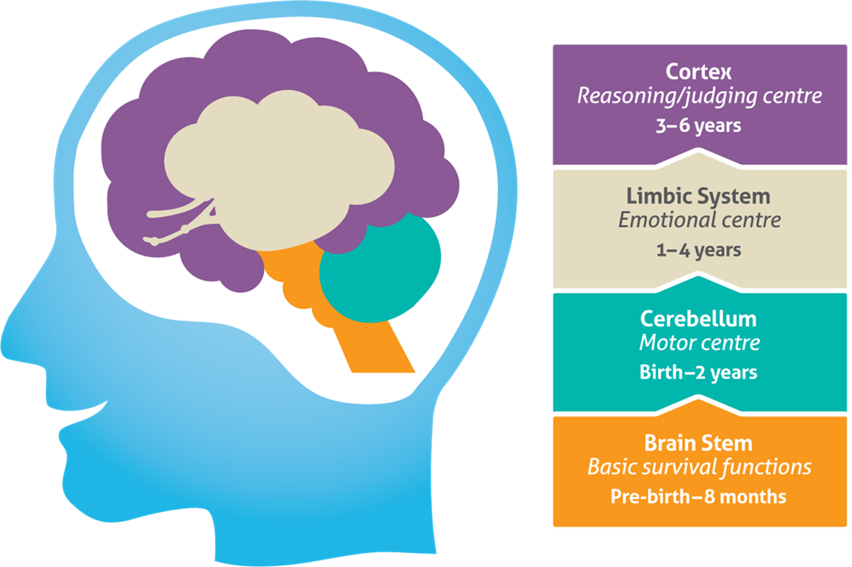
ACF Program Manager’s perspective
Vertical Brain Development
Kathryn

Slide 13
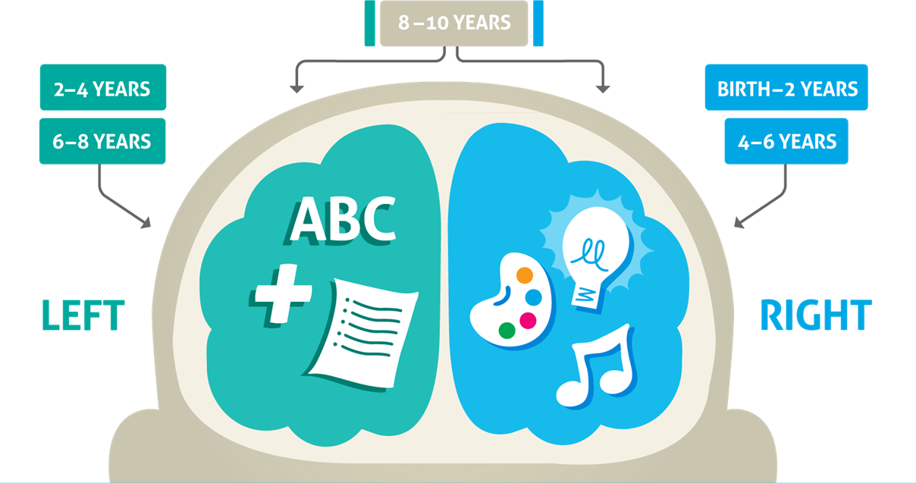
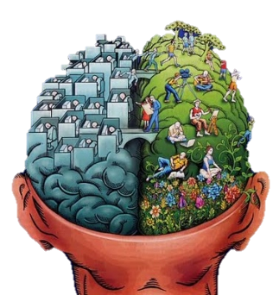
ACF Program Manager’s perspective
Horizontal Brain Development
Kathryn

Slide 14
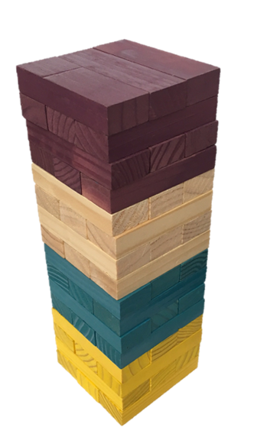
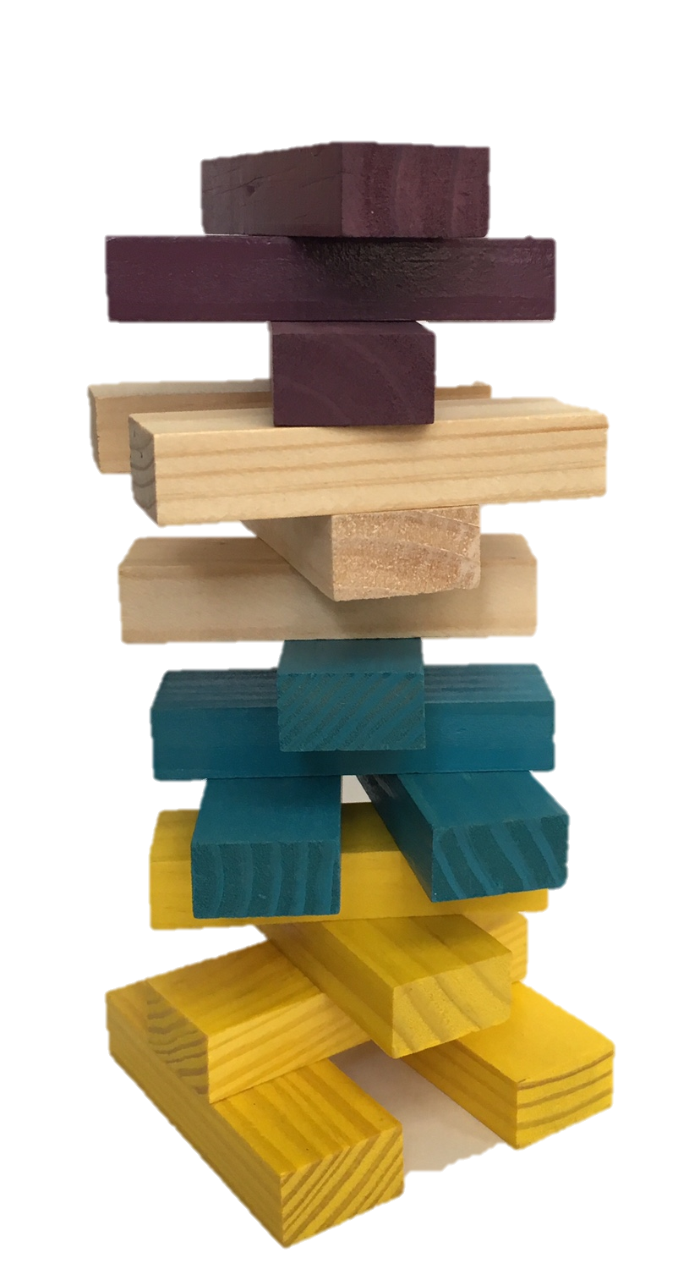
ACF Program Manager’s perspective
Building Blocks of Development
Kathryn
The neural structures of children’s brains are built on the foundations of repeated experiences.
These experiences may help form a strong tower that functions effectively and can withhold great pressures…
Or a brain structure adapted to toxic stress, with many connections yet to be realised due to unmet needs.

Slide 15
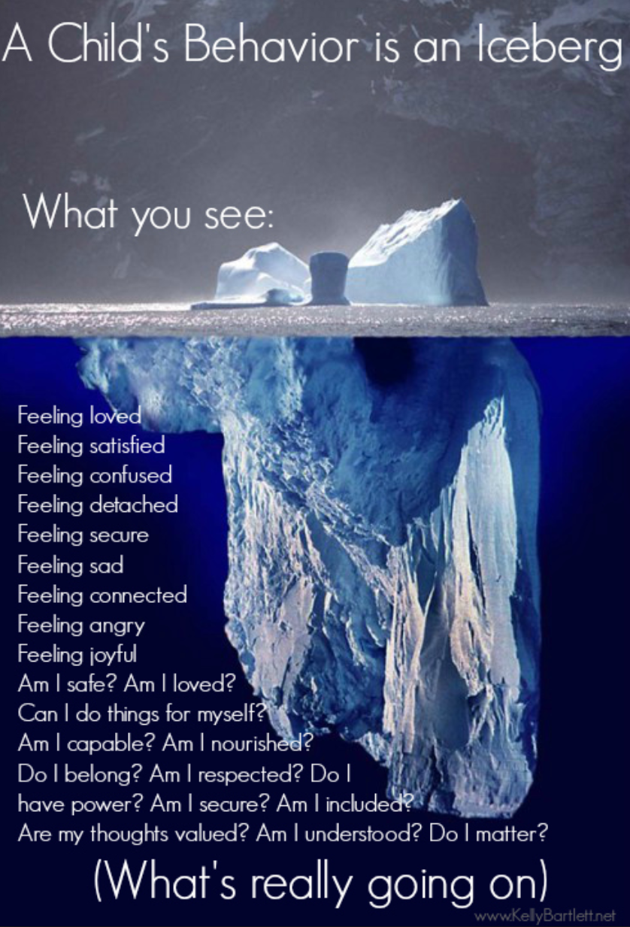
ACF Program Manager’s perspective
What are the unmet needs?
Kathryn
A core focus of recovery is identifying unmet needs in order to promote growth and healing.

Slide 16
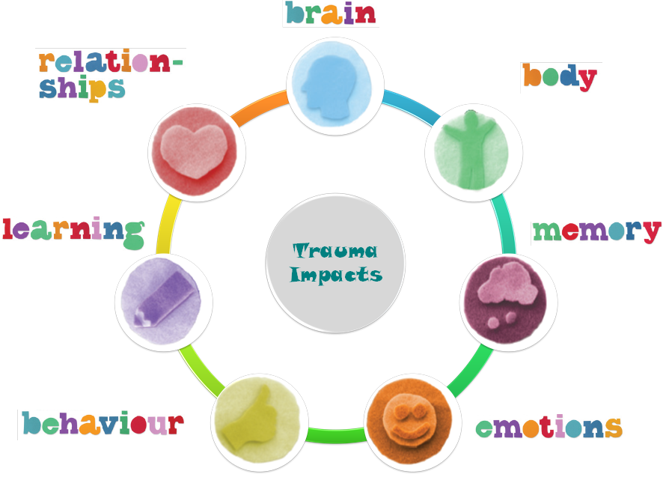
ACF Program Manager’s perspective
Impacts of Trauma - Fragmentation
Kathryn
The splintering of a child’s sense of self occurs in every way and creates fragmentation across their whole system.

Slide 17
ACF Program Manager’s perspective
Two Worlds
Now they have a foot in each of these worlds…
Kathryn

Slide 18
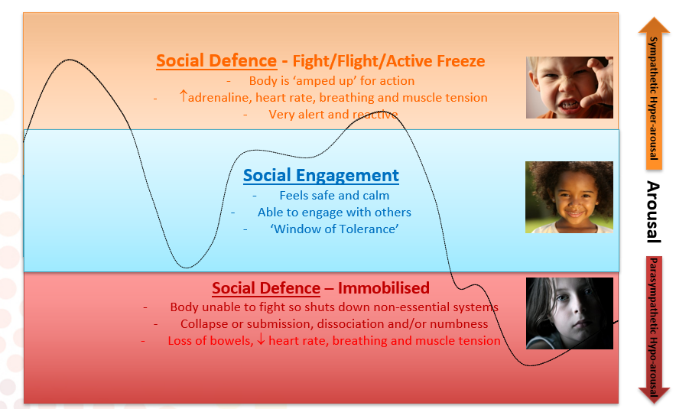
ACF Program Manager’s perspective
Window of Tolerance
Kathryn

Slide 19
ACF Program Manager’s perspective
Parenting with PACE to promote relational safety
Kathryn
Playful – light, open, hopeful, spontaneous.
Accepting – unconditional acceptance of the experience of the child (feelings, emotions and thoughts).
Curiosity – non-judgemental, active interest in the child’s experience, as well as behaviours to learn what is triggering them.
Empathy – about past hurts and present challenges. A ‘felt’ sense of the child, which is actively experienced and communicated.
Dan Hughes (2009)

Slide 20
ACF Program Manager’s perspective
Carer capacity and support needs
Kathryn

Slide 21
Perinatal and Infant Mental Health Specialist’s perspective
Alma-Jane
Theory to practice, supporting Jack in his early learning world : Practical interventions

Slide 22
Perinatal and Infant Mental Health Specialist’s perspective
What can we do?
Alma-Jane
Taking your service to Jack.
One hour therapy or embedding therapeutic interventions into his all-day activities.
Helping Jack make sense of HIS world.
ECEC can provide an opportunity for the traumatised infant to form relationships with others in a way that fosters trust, consistency & predictability.
For the ECEC educator to do this, they must be supported. (C. Ebert, S. Watson & R. Dolby, 2008).
Building staff capacity & encouraging thoughts about child behaviour in terms of social & emotional need will lead to staff being more predictable & emotionally available.

Slide 23
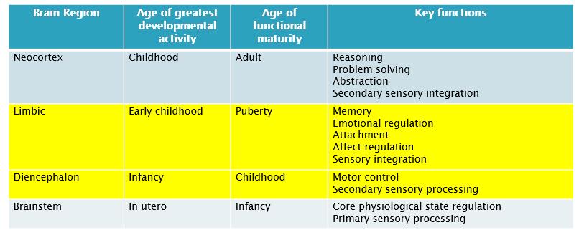
Perinatal and Infant Mental Health Specialist’s perspective
Considering Jack’s Brain Development for intervention
Alma-Jane

Slide 24
Perinatal and Infant Mental Health Specialist’s perspective
Considerations
Alma-Jane
How old is Jack developmentally, social emotional age?
Does this age match his peers?
Does his age match the classroom expectations?

Slide 25
Perinatal and Infant Mental Health Specialist’s perspective
Alma-Jane
“When children suffer trauma, they miss critical developmental stages. Allowing them to go backwards to recapture those stages is the answer to healing & eventually going forward.”
Heather T. Forbes, LCSW
www.beyondconsequences.com

Slide 26
Perinatal and Infant Mental Health Specialist’s perspective
Alma-Jane
Sharing your knowledge with educators

Slide 27
Perinatal and Infant Mental Health Specialist’s perspective
Classroom considerations: Environment
Alma-Jane
Noise – low voice tones
Movement – predictable/slow/naming initiatives. E.g., not using “Stop! I don’t like it” hand gestures
Predictable routines

Slide 28
Perinatal and Infant Mental Health Specialist’s perspective
Social Emotional Learning (SEL)
Alma-Jane
Kindness
Empathy
Patience
MindUp programme

Slide 29
Perinatal and Infant Mental Health Specialist’s perspective
Helping Jack make sense of his world
Alma-Jane
Naming initiatives
Narrating intentions of others
Social stories – pictures – of the good & tricky times

Slide 30
Perinatal and Infant Mental Health Specialist’s perspective
From Ghosts in the nursery to Angels in the nursery
Alma-Jane
Mothers who have had a childhood history of maltreatment but were not classified as abusive towards their children usually had either a positive, additional relationship with an adult or a significant positive relationship in their adult life.
The significant other could have been a childhood teacher, grandparent, uncle or aunt. In adulthood a love partner or a long-term therapeutic relationship.
This influence serves to change the “internal working model”, which can change the development of the infants working model for the next generation.

Slide 32
Q&A Session
Dr Jasmine MacDonald
Senior Research Officer
Australian Institute of Family Studies, VIC
Kathryn Lenton
Program Manager of
Therapeutic Services Australian Childhood Foundation, TAS
Alma-Jane O’Donnell
Perinatal and Infant Mental Health Specialist, SA
Facilitator:
Chris Dolman
Emerging Minds, SA

Slide 33
Thank you for participating
Please ensure you complete the feedback survey before you log out. Click the yellow speech bubble icon in the top right hand corner of your screen to open the survey.
Statements of Attendance for this webinar will be issued within four to six weeks.
Each participant will be sent a link to the recording of this webinar and associated online resources within four to six weeks.

Slide 34
Resources and further reading
Other supporting resources associated with this webinar can be found by clicking on the supporting resources icon.
For more information about Emerging Minds, visit www.emergingminds.com.au
Upcoming webinars in 2022:
Assessment and engagement with infants and children (7 April)
Building parents’ understanding of play to promote infant mental health (June)
MHPN webinars in 2022:
Suicide prevention for LGBTQIA+ communities (22 March)

Slide 35
This webinar was co-produced by MHPN and Emerging Minds for the Emerging Minds: National Workforce Centre for Child Mental Health (NWCCMH) project.
The NWCCMH is funded by the Australian Government Department of Health under the National Support for Child and Youth Mental Health Program.

Slide 36
MHPN supports over 350 networks across the country where mental health practitioners meet either in person or online to discuss issues of local importance.
Visit www.mhpn.org.au to join your local network.
Interested in starting a new network? Email: networks@mhpn.org.au and we will step you through the process, including explaining how we can provide advice, administration and other support.

Slide 37
Thank You

